Slide 1


Part I
2. Process Modeling
Dimitris SACHARIDIS
2023-2024

Slide 2















BPM structure
Process identification
Process
discovery
Process monitoring and controlling
Process
analysis
Process
implementation
Process
redesign
2

Slide 3





BPMN Main Elements - Recap
Flow Objects
Connections
Message
Association
Activity
Gateway
Event
Flow
Pools & lanes
Artifacts
Pool
Data Object
Data Store
Lane

Slide 4


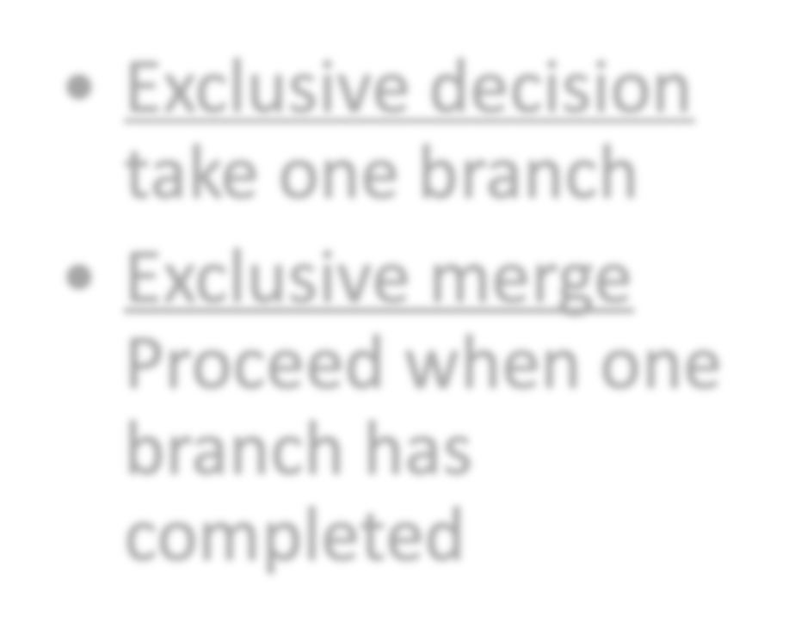


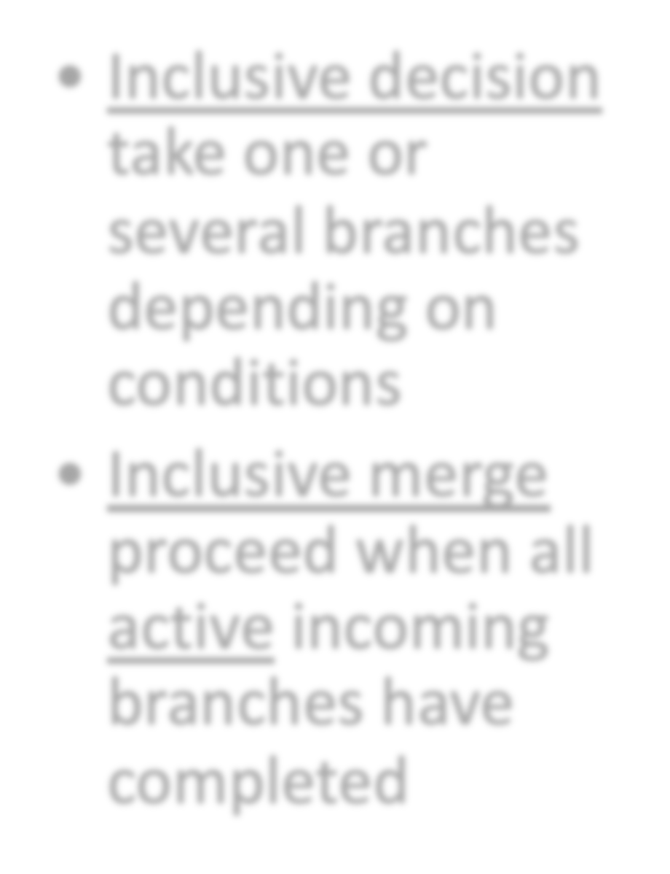
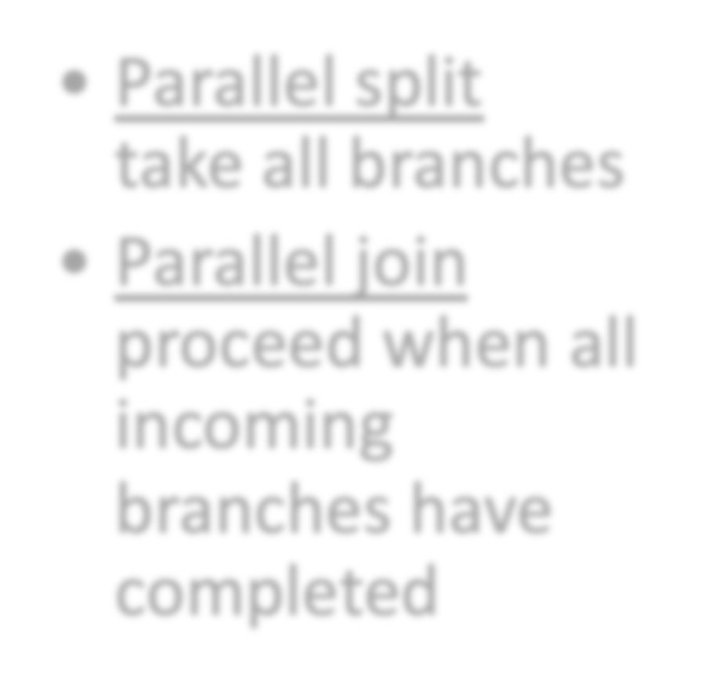

BPMN Gateways
Exclusive (XOR)
Parallel (AND)
Inclusive (OR)
Exclusive decision take one branch
Exclusive merge Proceed when one branch has completed
Parallel split take all branches
Parallel join proceed when all incoming branches have completed
Inclusive decision take one or several branches depending on conditions
Inclusive merge proceed when all active incoming branches have completed

Slide 5
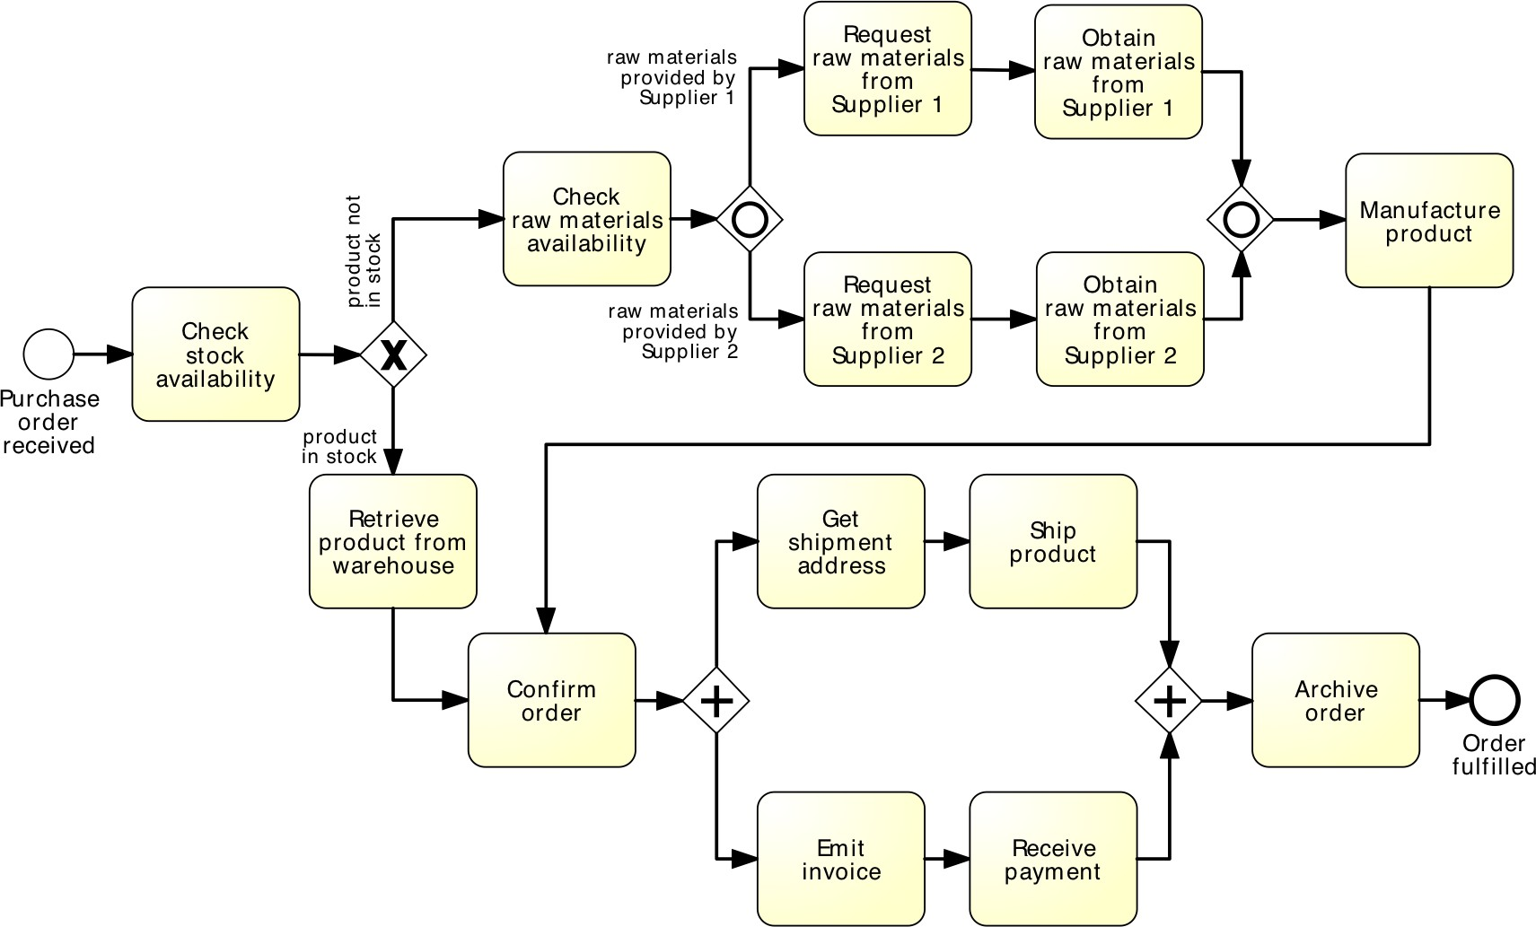
Critique this model

Slide 6
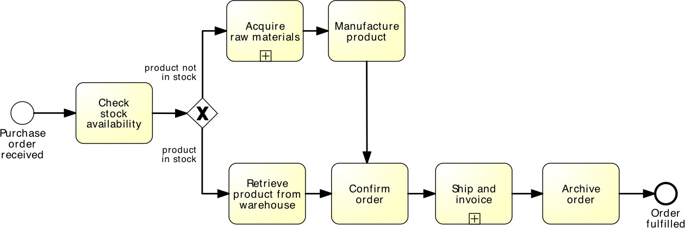
Is this better?

Slide 7
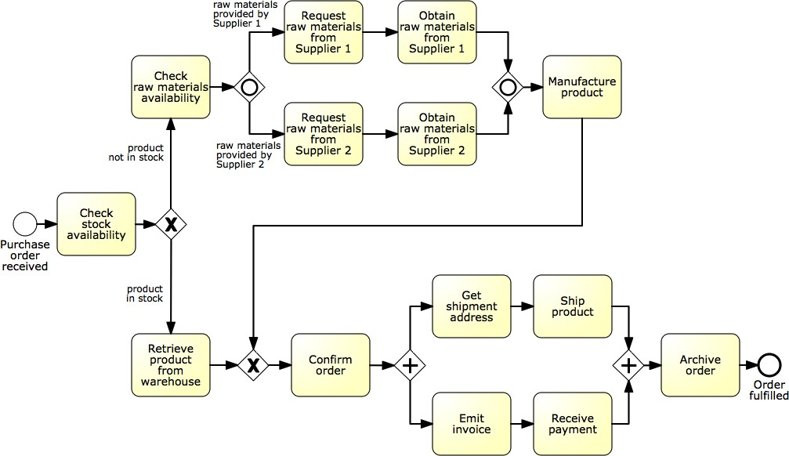
Identifying sub-processes
Acquire raw materials
Ship and invoice
7

Slide 8
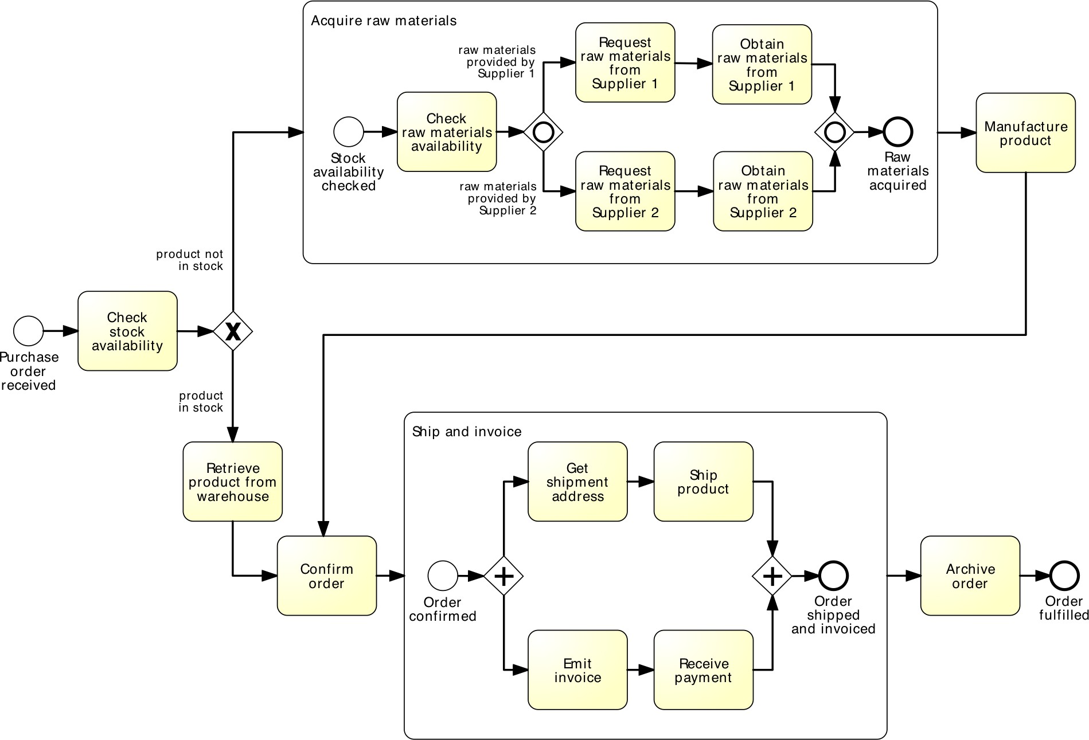
Using the Expanded Sub-Process Notation

Slide 9
Sub-processes
An activity in a process can invoke a separate sub-process
Use this feature to:
Decompose large models into smaller ones, making them easier to understand and maintain

Slide 10
Guideline: Multi-level modeling
Level 1: value chain
Simple linear description of the phases of the process
No gateways
Each activity chain is a sub-process
Level 2+: expand each activity in the value chain, add incrementally the following:
Decisions, handoffs (lanes, pools)
Parallel gateways, different types of events
Data objects & data stores
And as much detail as you need, and no more

Slide 11
Guideline: Multi-level modeling (cont.)
At each level, decompose according to:
Logical milestones towards achieving the outcome of the process
Major objects used in the process
Decompose until processes are of “reasonable” size
e.g., up to 20 nodes (tasks+events+gateways) per model

Slide 12

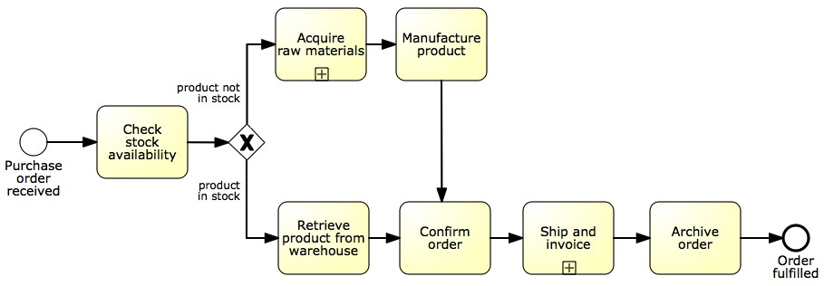
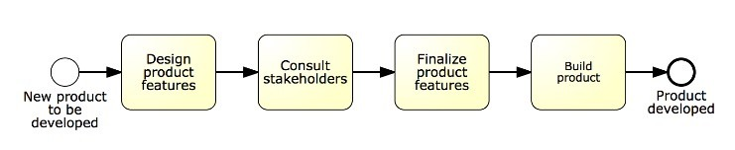
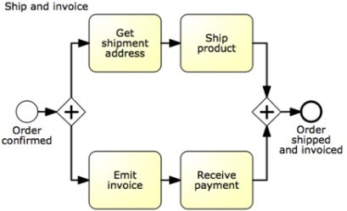
Non-BPMN value chain “chevron” notation
Collapsed process model

Slide 13
Sub-processes
An activity in a process can invoke a separate sub-process
Use this feature to:
Decompose large models into smaller ones, making them easier to understand and maintain
Share common fragments across multiple processes

Slide 14
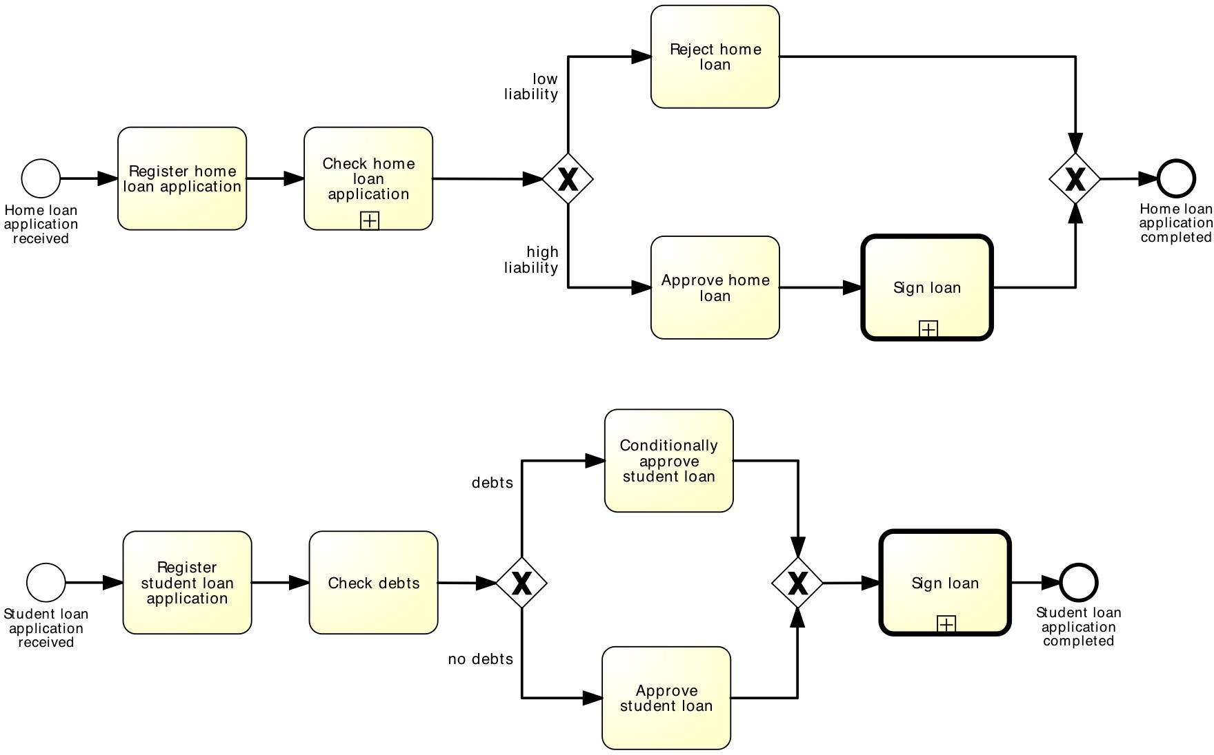
Shared sub-process

Slide 15
Sub-processes
An activity in a process can invoke a separate sub-process
Use this feature to:
Decompose large models into smaller ones, making them easier to understand and maintain
Share common fragments across multiple processes
Delimit parts of a process that can be:
Repeated
Interrupted

Slide 16
STRUCTURED REPETITION

Slide 17

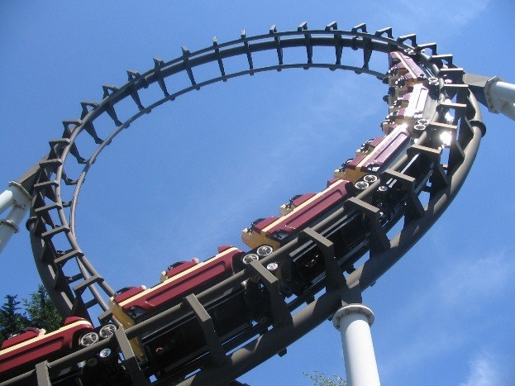
Block-structured repetition: Activity loop
Activity loop markers allow us to state that a task or a sub- process may be repeated multiple times
Task Loop
Sub-process Loop
17

Slide 18
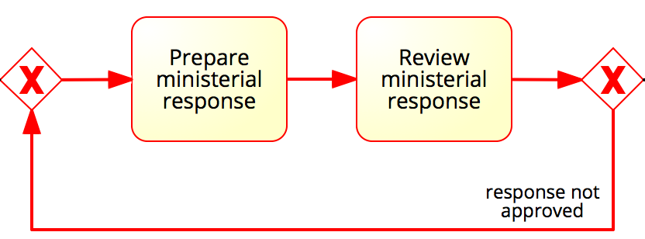
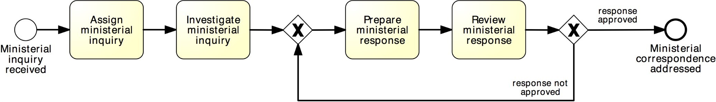
More on rework and repetition
XOR-join: entry point
XOR-split: exit point
Structured cycle
single-entry-single-exit (SESE) component
18

Slide 19
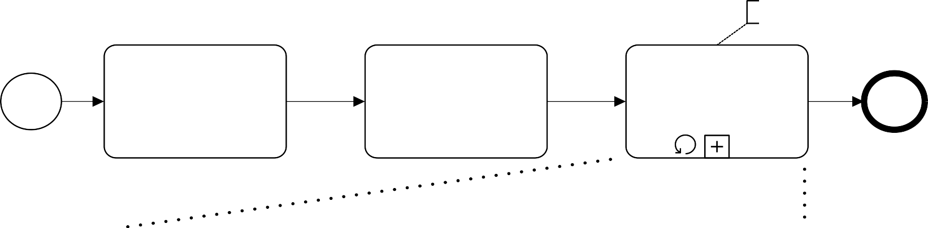
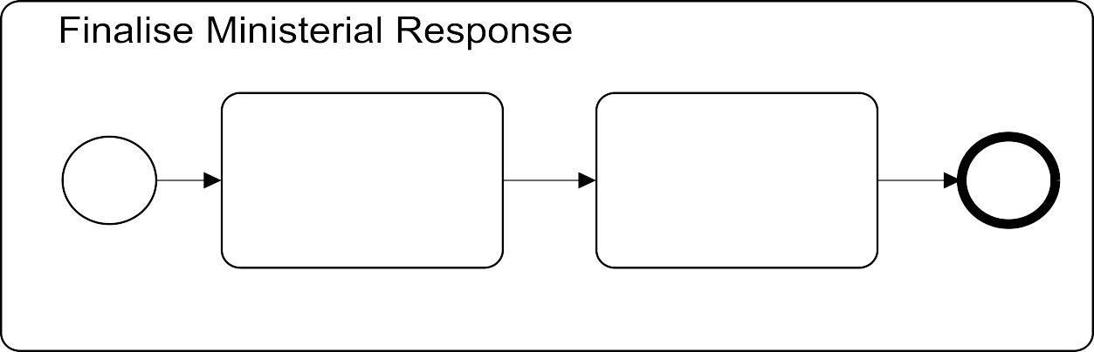
Example: block-structured repetition
Completion condition
Until Response is approved
Assign Ministerial Enquiry
Investigate Ministerial Enquiry
Finalise Ministerial Response
Ministerial Enquiry received
Ministerial Enquiry finilized
Prepare Ministerial Response
Review Ministerial Response
Enquiry investigated
Response reviewed
Must have a decision activity

Slide 20
Parallel repetition: multi-instance activity
The multi-instance activity provides a mechanism to indicate that an activity is executed multiple times concurrently
Multi-Instance Task
Multi-Instance Sub-process
Useful when the same activity needs to be executed for multiple entities or data items, such as:
Request quotes from multiple suppliers
Check the availability for each line item in an order separately
Send and gather questionnaires from multiple witnesses in the context of an insurance claim

Slide 21
Example: multi-instance activity
Procurement
In procurement, typically a quote is to be obtained from all preferred suppliers (assumption: five preferred suppliers exist). After all quotes are received, they are evaluated and the best quote is selected. A corresponding purchase order is then placed.

Slide 22
Is this elegant?
Procurement
Obtain Quote
from Supplier A
Obtain Quote
from Supplier B
...
Obtain Quote from Supplier C
Select best quote
Place PO
...
Obtain Quote
from Supplier D
Obtain Quote
from Supplier E

Slide 23
Solution: with multi-instance activity
Procurement
cardinality
For each supplier
...
Obtain Quote
Select best
quote
Place PO
...

Slide 24
EVENTS

Slide 25
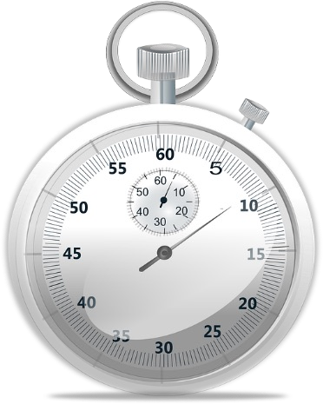

Events
In BPMN, events model something instantaneous happening during the execution of a process
Types of event:
Start
Intermediate
End

Slide 26
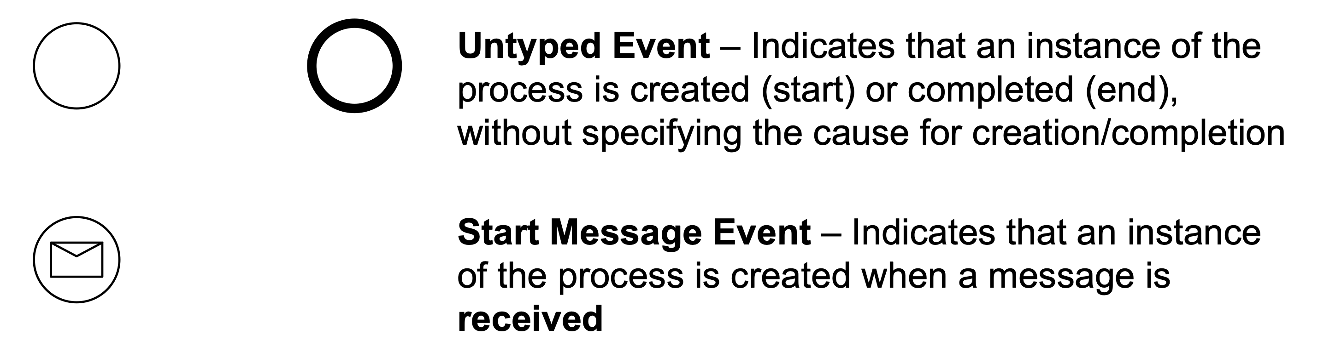
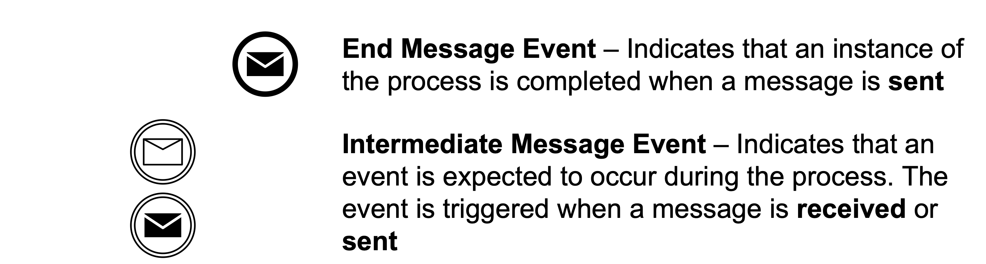
BPMN event types
Start Intermediate End

Slide 27

Comparison with sending/receiving tasks
=
Receive invoice
Invoice received
=
Send invoice
Invoice sent
=
Send invoice
Invoice sent
≠
Receive
invoice
Invoice received

Slide 28
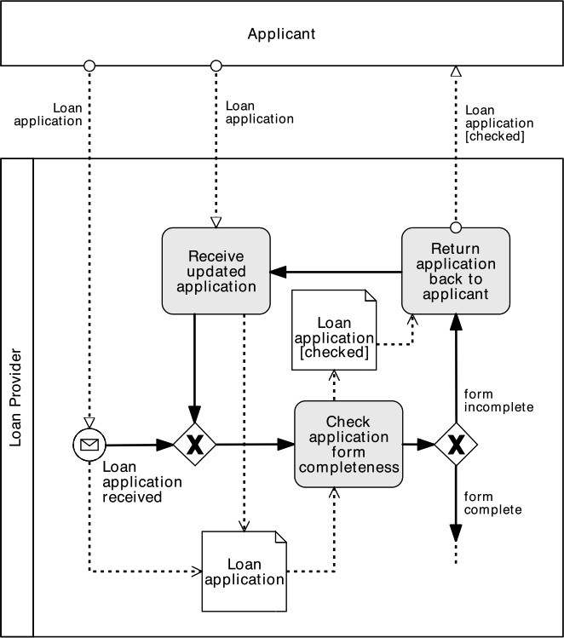
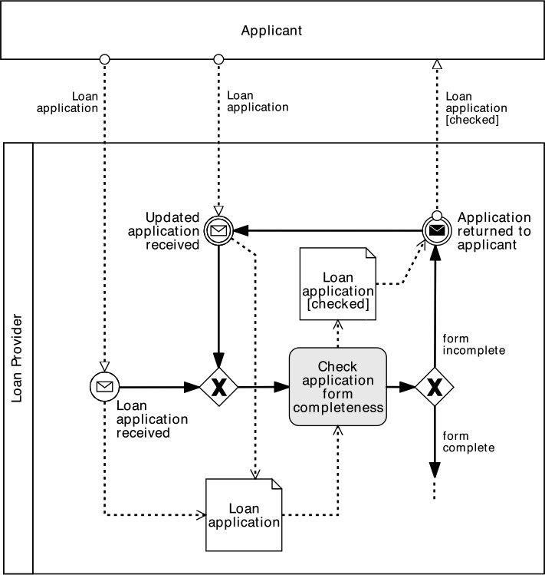
So, when to use what?
Use message events only when the corresponding activity would simply send or receive a message and do nothing else

Slide 29
Temporal events
Start
Intermediate End
Start Timer Event – Indicates that an instance of the process is created at certain date(s)/time(s), e.g. start process at 6pm every Friday
Intermediate Timer Event – Triggered at certain date(s)/ time(s), or after a time interval has elapsed since the moment the event is “enabled” (delay)

Slide 30

Example
PO handling
A Purchase Order (PO) handling process starts when a PO is received. The PO is first registered. If the current date is not a working day, the process waits until the following working day before proceeding. Otherwise, an availability check is performed and a PO response is sent back to the customer.
Next working day
weekend/ holiday
Register PO
weekday
Check Availability
Send PO
Response
PO
Received
PO
fulfilled

Slide 31



Recap: Message and Timer events
Start
Catching
Intermediate
Throwing
End
Throwing
Catching
process starts upon message received
message received during the process
message sent during the process
process ends upon message sent
process starts when time event occurs
time event occurred
(to model delay)
31

Slide 32
Data-based vs. Event-based decision
With the XOR-split gateway, a branch is chosen based on conditions that evaluate over available data
→ The choice can be made immediately after the token arrives from the incoming flow
Sometimes, the choice must be delayed until an event happens
→ The choice is based on a “race” among events
Two types of XOR split:
data-driven XOR-split
event-driven XOR split
32

Slide 33
Choices outside our control…
Stock replenishment
A restaurant chain submits a purchase order (PO) to replenish its warehouses every Thursday. The restaurant chain’s procurement system expects to receive either a “PO Response” or an error message. However, it may also happen that no response is received at all due to system errors or due to delays in handling the PO on the supplier’s side. If no response is received by Friday afternoon or if an error message is received, a purchasing officer at the restaurant chain’s headquarters should be notified. Otherwise, the PO Response is processed normally.
1

Slide 34
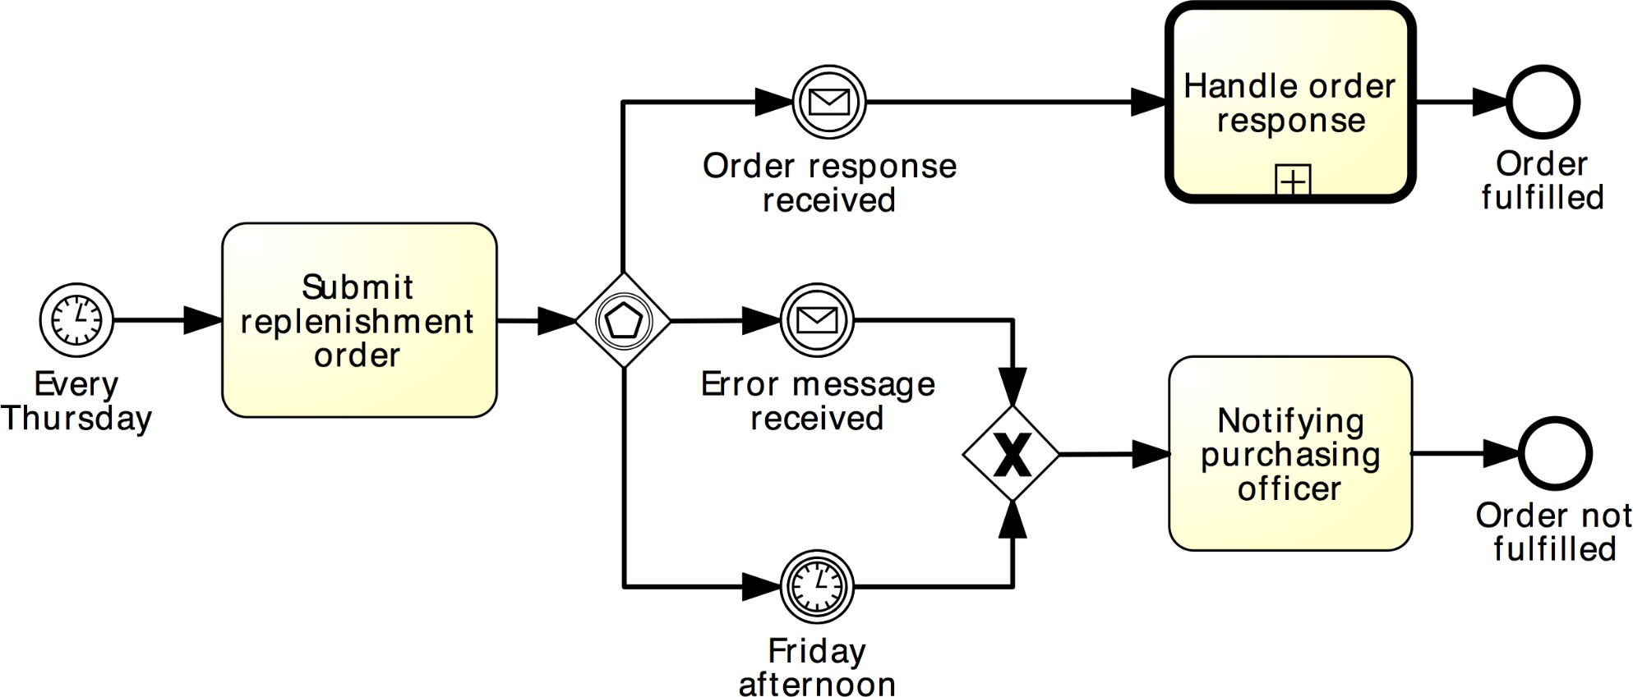
Solution: event-driven XOR split
Stock replenishment
34

Slide 35
EXCEPTION HANDLING

Slide 36
Abortion (terminate event)
Exceptions are events that deviate a process from its “normal” course
The simplest form of exception is to notify that there is an exception (negative outcome)
This can be done via the Terminate end event: it forces the whole process to abort (“wipes off” all tokens left behind, if any)

Slide 37
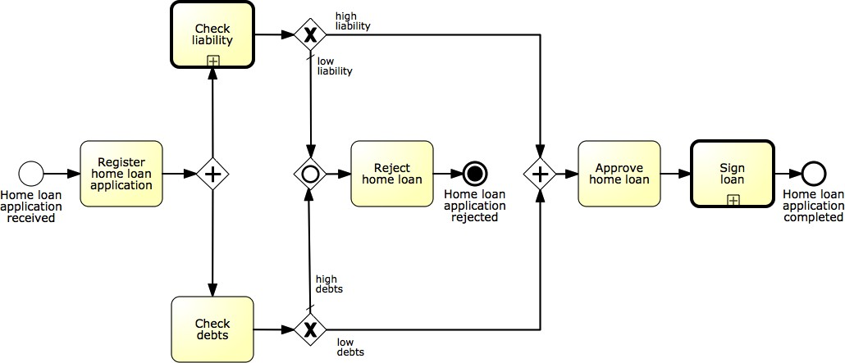
Example: terminate event
Abort the process by removing all tokens…

Slide 38
Exception handling
Handling exceptions often involves stopping a sub-process and performing a special activity
Types of exceptions for an activity (task/sub-process) in BPMN:
External: something goes wrong outside the process, and the execution of the current activity must be interrupted. Handled with the Message event
Internal: something goes wrong inside an activity, whose execution must thus be interrupted. Handled with the Error event
Timeout: an activity takes too long and must be interrupted. Handled with the Timer event
All these events are catching intermediate events. They stop the enclosing activity and start an exception handling routine.

Slide 39
Let’s extend our PO handling process
PO handling
A PO handling process starts when a PO is received. The PO is first registered. If the current date is not a working day, the process waits until the following working day before proceeding. Otherwise, an availability check is performed and a PO response is sent back to the customer.
Next working day
weekend/ holiday
Register PO
weekday
Check Availability
Send PO
Response
PO
Received
PO
fulfilled

Slide 40

Let’s extend our PO handling process
PO handling
Next working day
weekend/ holiday
Register PO
weekday
Check Availability
Send PO
Response
PO
Received
PO
fulfilled
A PO change request may be received anytime after the PO is registered. This request includes a change in quantity or line items. When such a request is received, any processing related to the PO must be stopped. The PO change request is then registered. Thereafter, the process proceeds as it would do after a normal PO is registered. Further, if the customer sends a PO cancelation request after the PO registration, the PO processing must be stopped and the cancelation request must be handled.

Slide 41
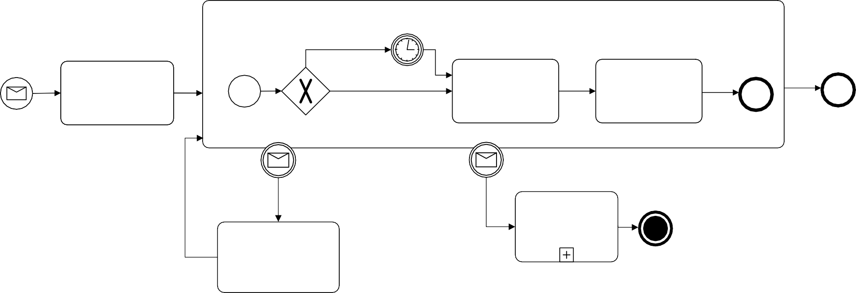
Solution: exception handling
PO handling
Handle PO
Next workingNdeaxyt working day
weekend/ holiday
weekend/ holiday
Register PO
weekday
weekday Check
Availability
Check
Send PO
Send PO Response
PO
fulfilled
Availability Response
PO
Received
PO
Registered
Response sent
PO
fulfilled
PO Change received
PO Cancel received
Handle PO Cancelation
Register PO Change
PO
canceled
8

Slide 42

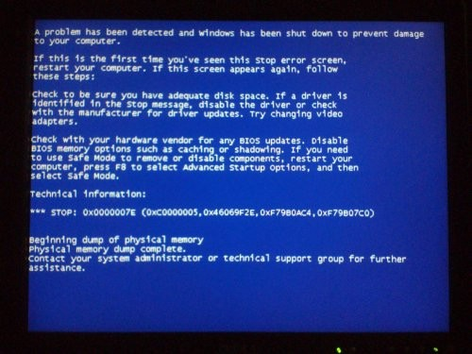
Internal exception: error event
Start
Intermediate End
Error Event – Indicates an error: the “end” version generates an error event while the “catching intermediate” version consumes it when attached to the boundary of an activity
Must be attached to the activity’s boundary

Slide 43
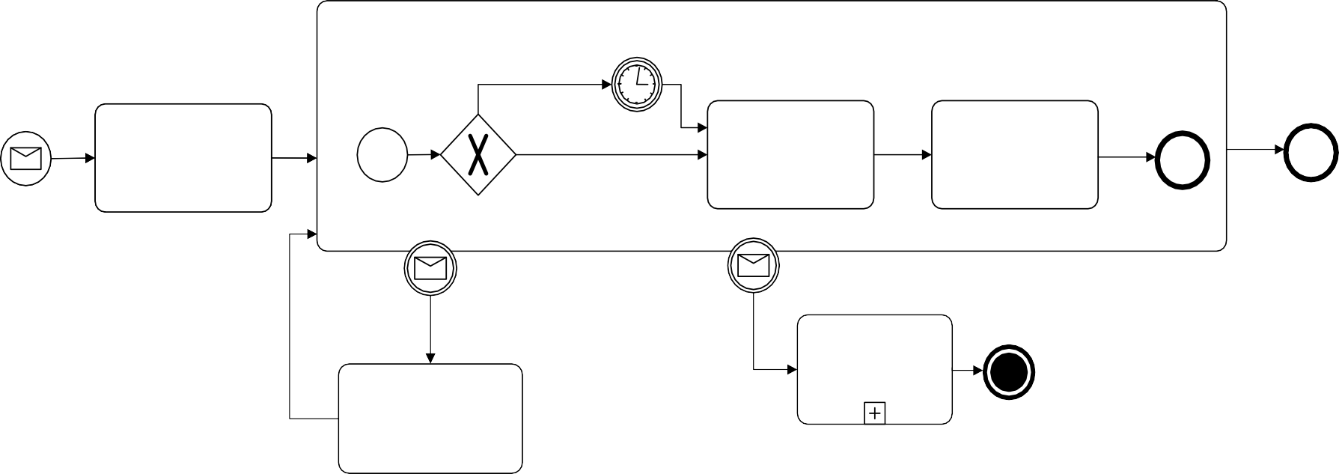
Example: internal exception
PO handling
Consider again our “PO Handling process” example with the following extension: if an item is not available, any processing related to the PO must be stopped. Thereafter, the client needs to be notified that the PO cannot be further processed.
Handle PO
Next workingNdeaxyt working day
weekend/ holiday
weekend/ holiday
Register PO
weekday
weekday Check
Availability
Check
Send PO
Send PO Response
PO
fulfilled
Availability Response
PO
Received
PO
Registered
Response sent
PO
fulfilled
PO Change received
PO Cancel received
Handle PO Cancelation
Register PO Change
PO
canceled

Slide 44
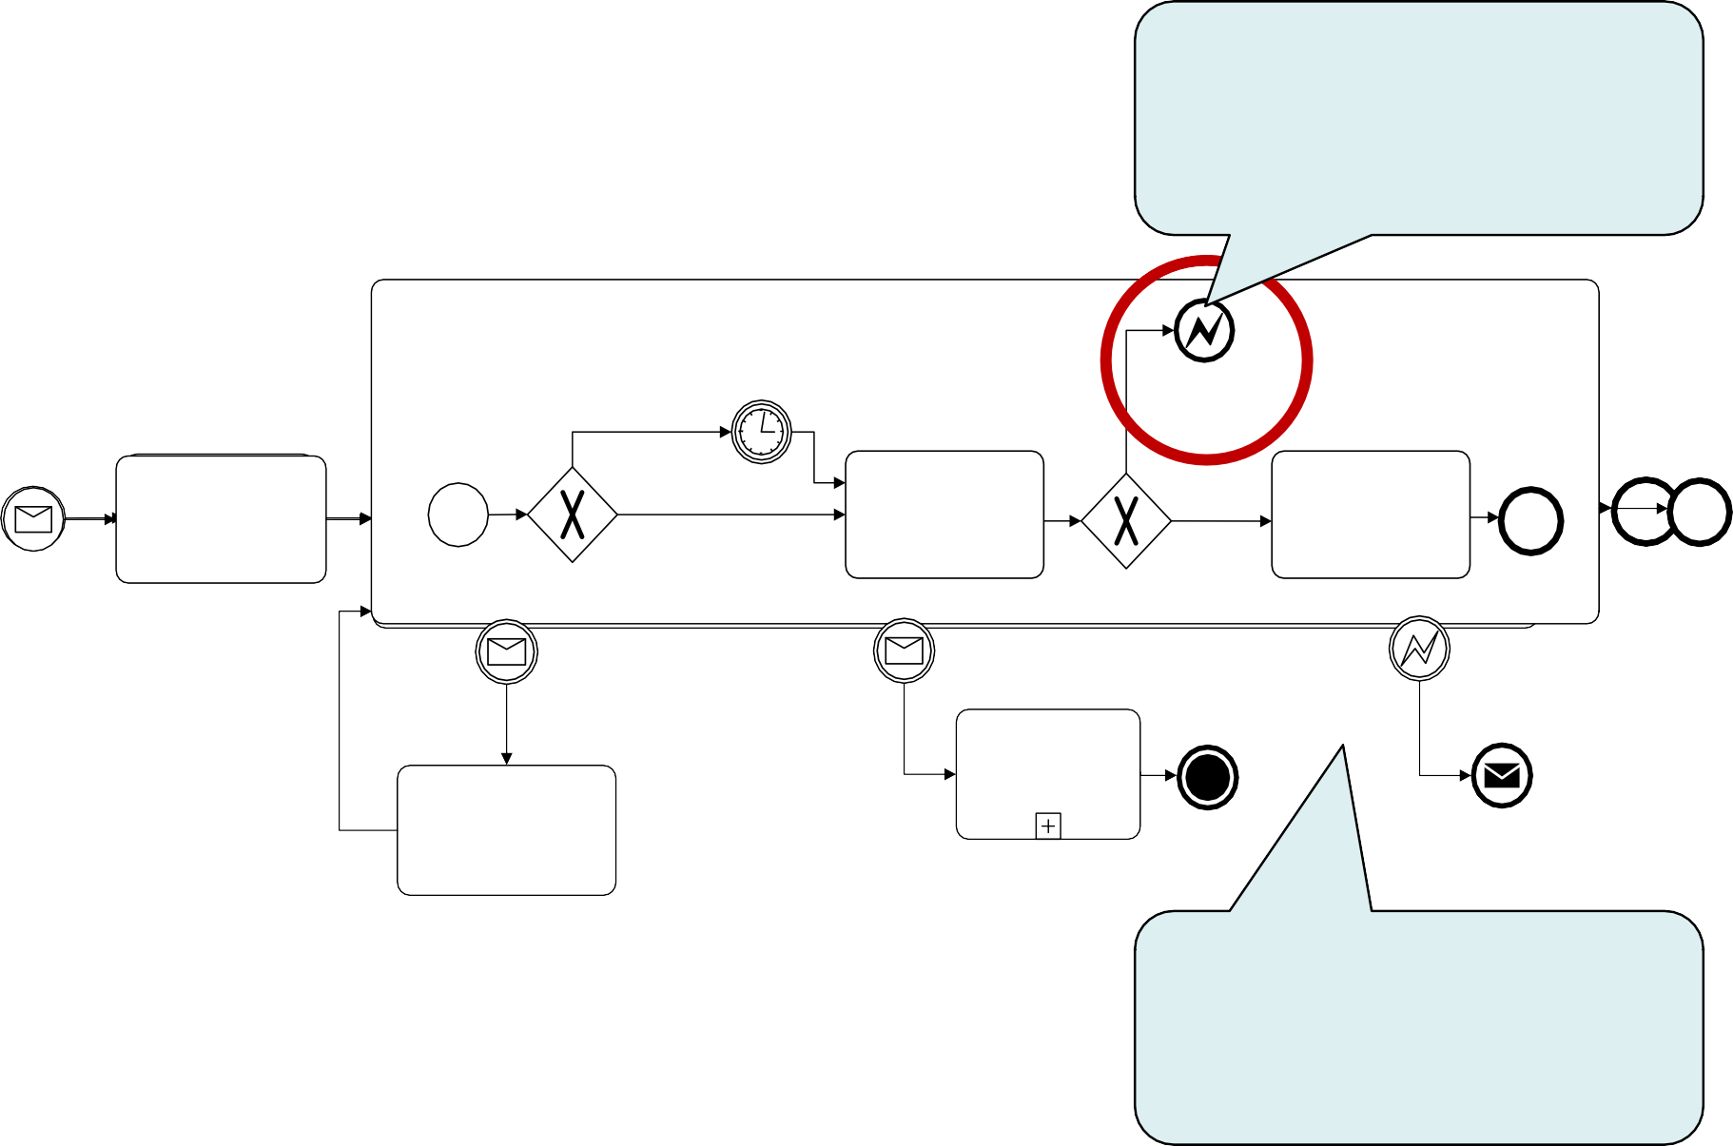
Solution: internal exception
Throwing and catching error events must have the same label
PO handling
Handle PO
Handle PO
NNexetxwt owrokirnkgindgadyay
wweeeekkeenndd/ /
hhoolildidaayy
Items not available
RReeggiisstteerr PPOO
wweeekedkadyay
CheCchkeck
AvaAivlaabiillaitbyility
Send POSend PO _{Ite}R_{m}e_{s}sponsRe esponse
PPOO
RReecceeiivveedd
PPOO
RReeggiisstteerreedd
available
RespRoensspeonse
sentsent
PO PO
fulfillefudlfilled
PO Change received
PO Cancel received
Items not available
Handle PO Cancelation
Register PO Change
PO
canceled
Notification sent
Must catch an error event thrown from within the same activity

Slide 45
Example: activity timeout
Order-to-transportation quote
Once a wholesale order has been confirmed, the supplier transmits this order to the carrier for the preparation of the transportation quote. In order to prepare the quote, the carrier needs to compute the route plan (including all track points that need to be traversed during the travel) and estimate the trailer usage.
By contract, wholesale orders have to be dispatched within four days from the receipt of the order. This implies that transportation quotes have to be prepared within 48 hours from the receipt of the order to remain within the terms of the contract.

Slide 46
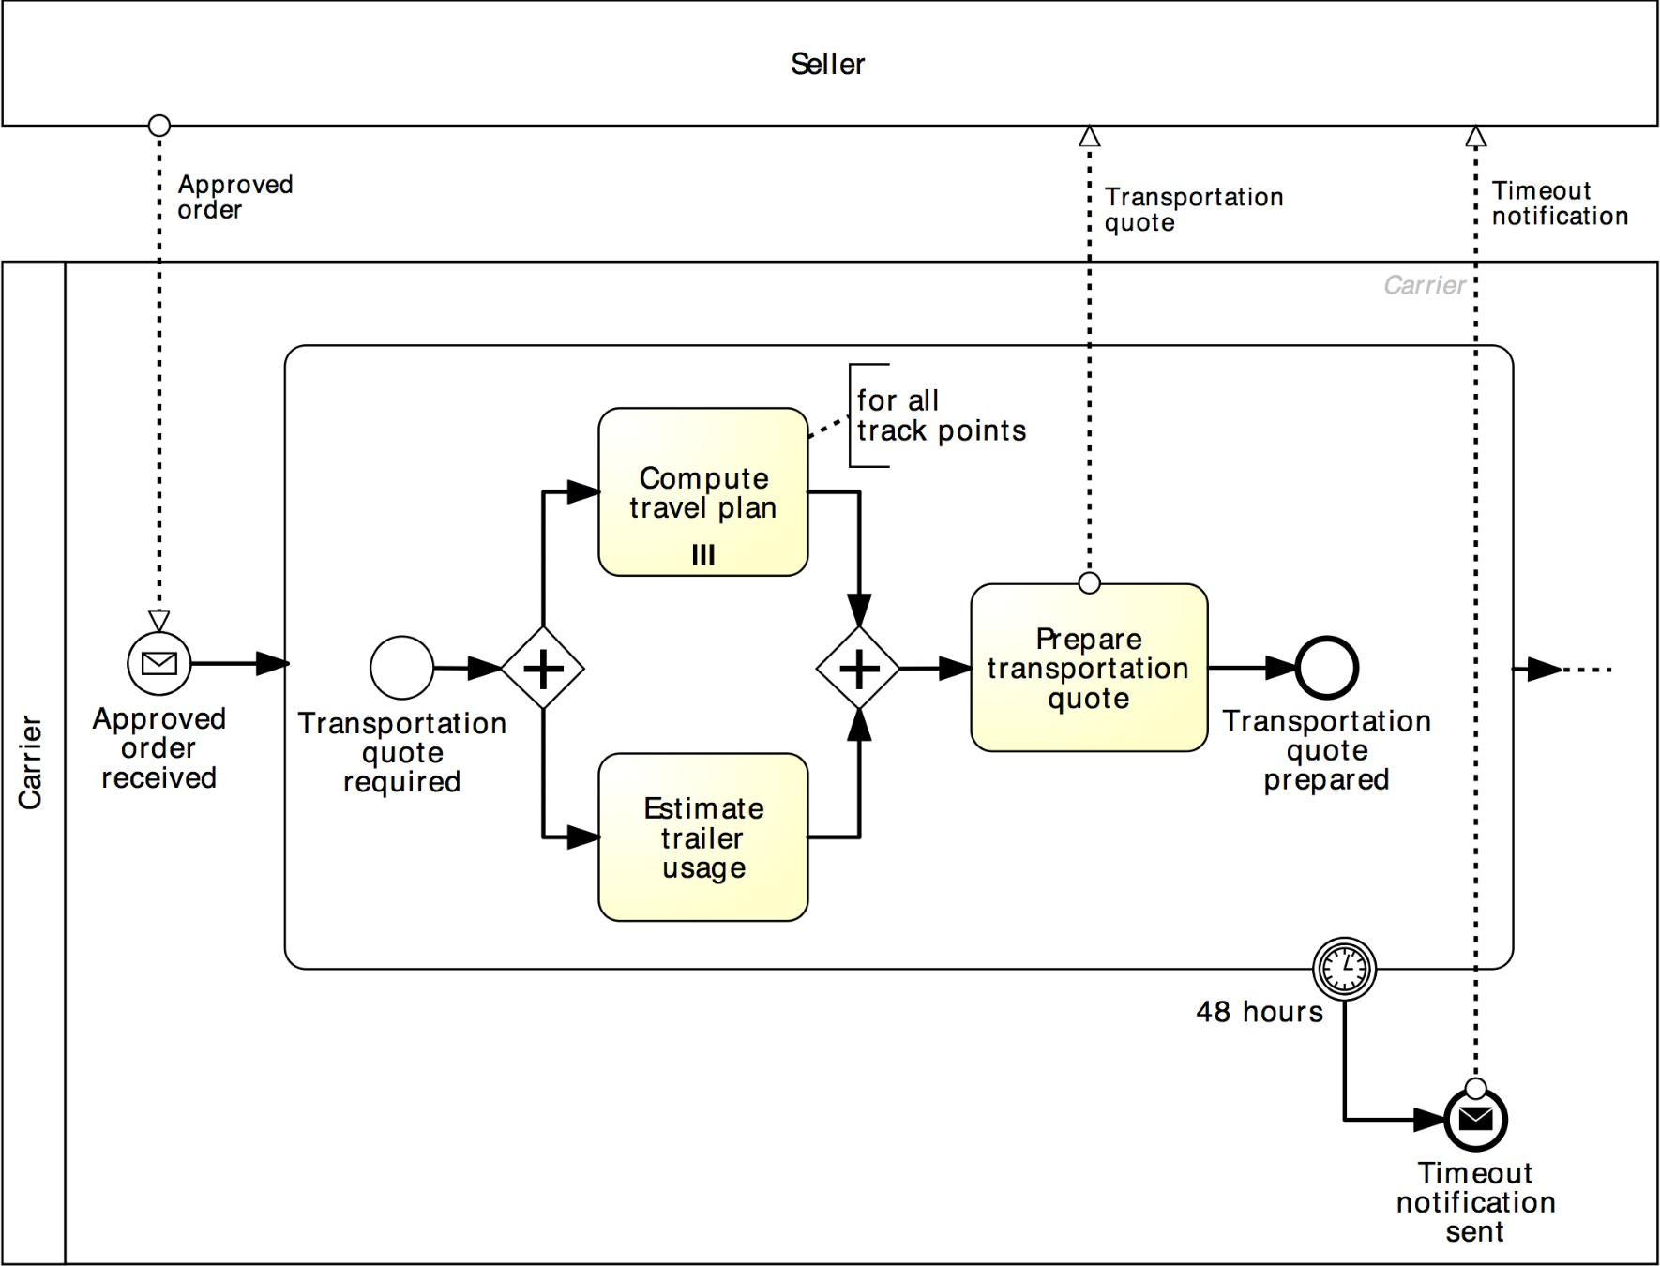
Solution: activity timeout
Order-to-transportation quote

Slide 47
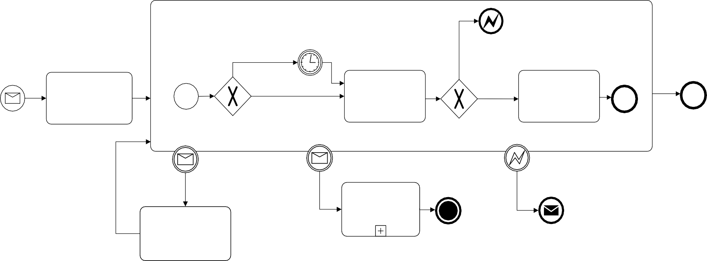
More on the PO handling example…
PO handling
Handle PO
Next working day
Items not available
weekend/ holiday
Register PO
weekday
Check Availability
Send PO Response
PO
Registered
Items available
PO
fulfilled
PO
Received
Response sent
PO Change received
PO Cancel received
Items not available
Handle PO Cancelation
Register PO
Change
PO
canceled
Notification sent
The customer may send a request for address change after the PO registration. When such a request is received, it is just registered, without further action.

Slide 48
Non-interrupting boundary events
Sometimes we may need to trigger an activity in parallel to the normal flow, i.e. without interrupting the normal flow.
This can be achieved by using non-interrupting boundary events
Must be attached to the activity’s boundary

Slide 49
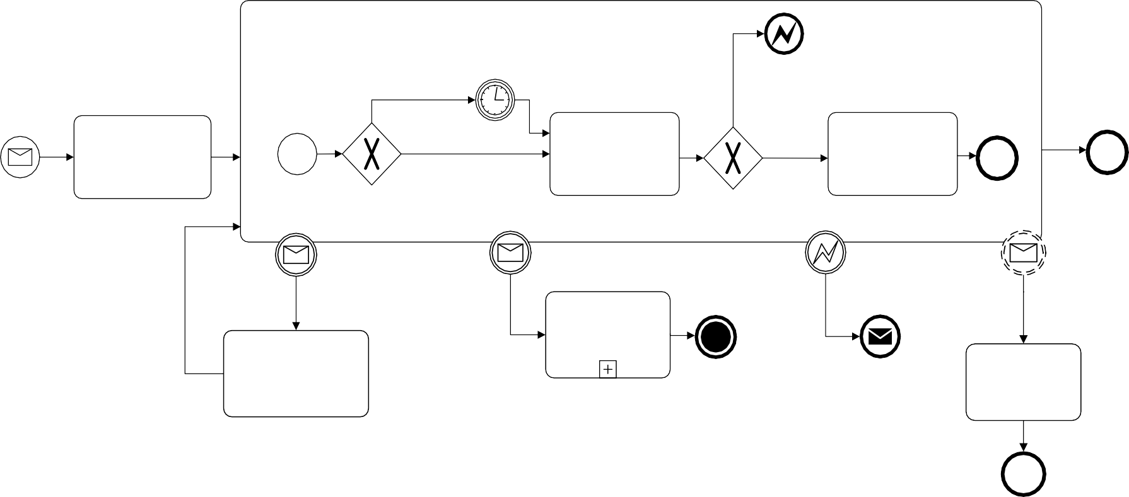
Solution: non-interrupting boundary events
PO handling
Handle PO
Next working day
Items not available
weekend/ holiday
Register PO
weekday
Check Availability
Send PO Response
PO
Registered
Items available
PO
fulfilled
PO
Received
Response sent
PO Change received
PO Cancel received
Items not available
Address change received
Update customer address
Handle PO Cancelation
Register PO
Change
PO
canceled
Notification sent
Customer address updated

Slide 50
Summary
In this lecture we have learned about:
BPMN sub-processes
Repetition markers: loop marker and parallel multi-instance marker
Events: timer, message and error events
Event-based choice gateway
Boundary events: interrupting and non-interrupting
Error events (throw and catch)

